Slide 1

&
TheBoys

Slide 2

Problem Statement
Help people to find nearby CHAS clinics

Slide 3




Requirement Elicitation
Requirement Analysis
Design & Implementation
Testing

Slide 5



Requirement Elicitation

Slide 6
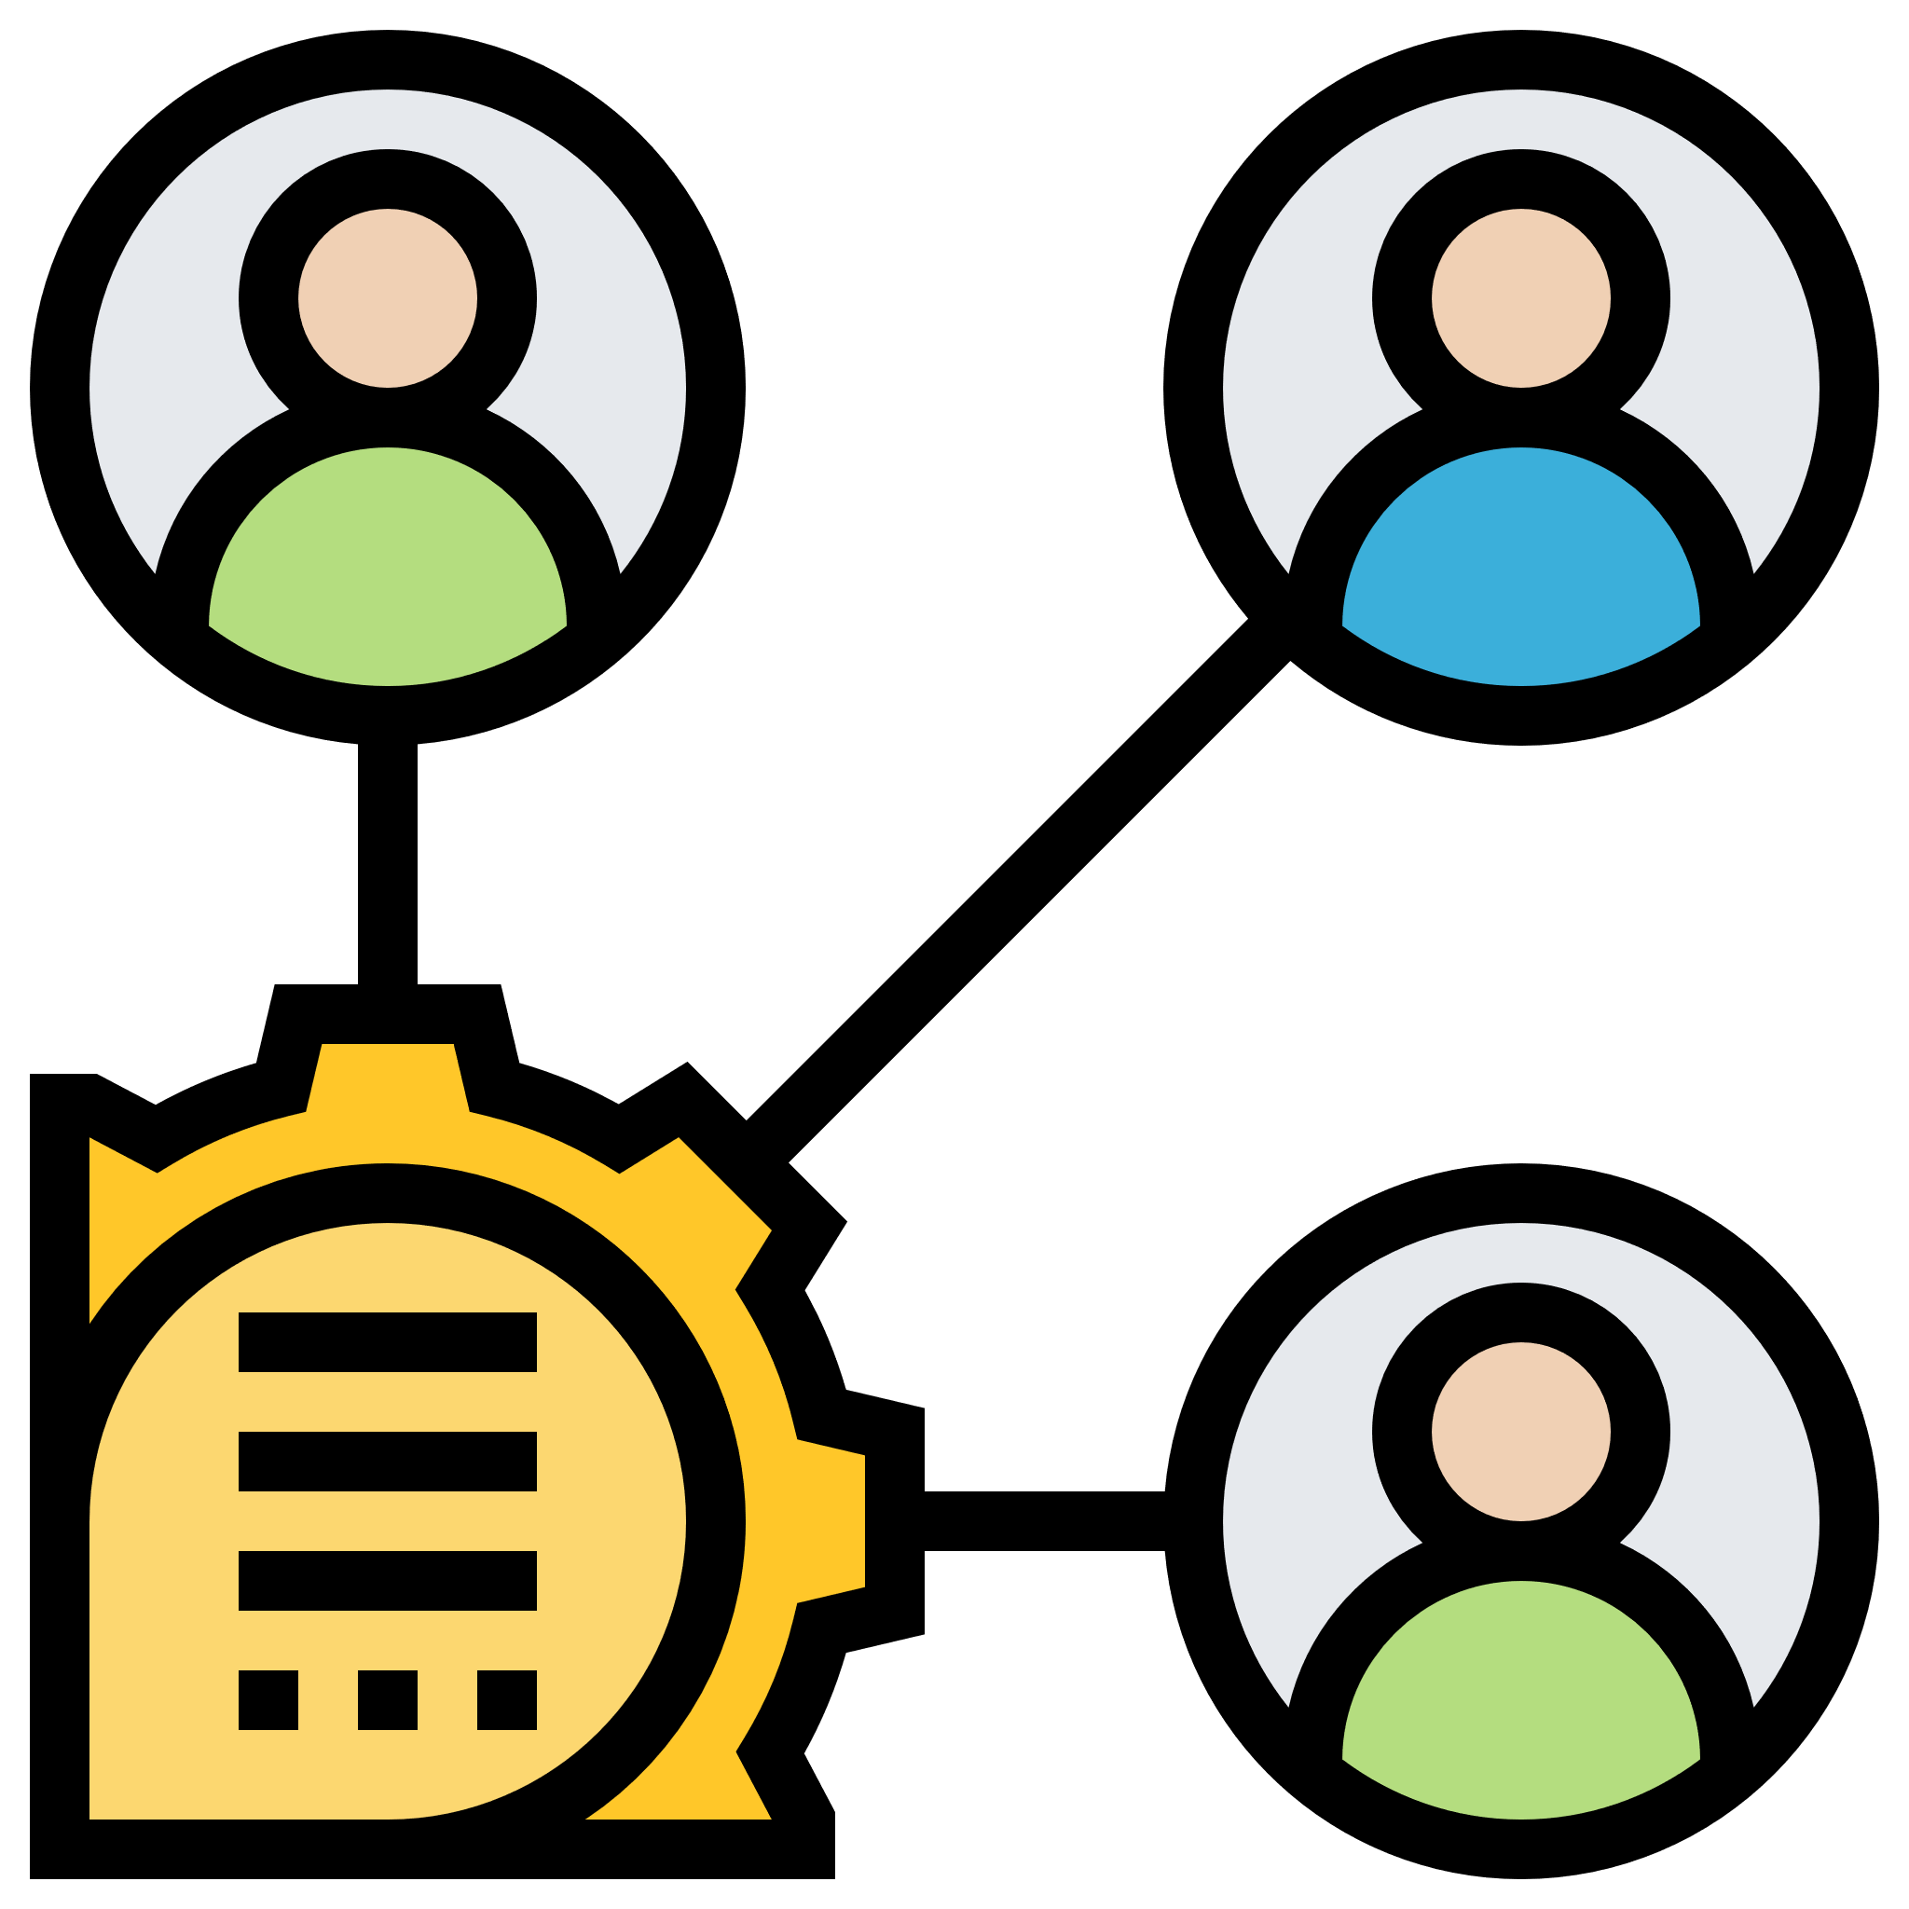
Who?
Stakeholders
Clinic Patient
Clinic Staff
Developer
Tester

Slide 7

How?
Identify required features
Find needs of the user
Examine existing mapping services

Slide 8
What?
Functional Requirement
Non-functional requirement
Use Case
Data Dictionary
UI Prototype

Slide 9

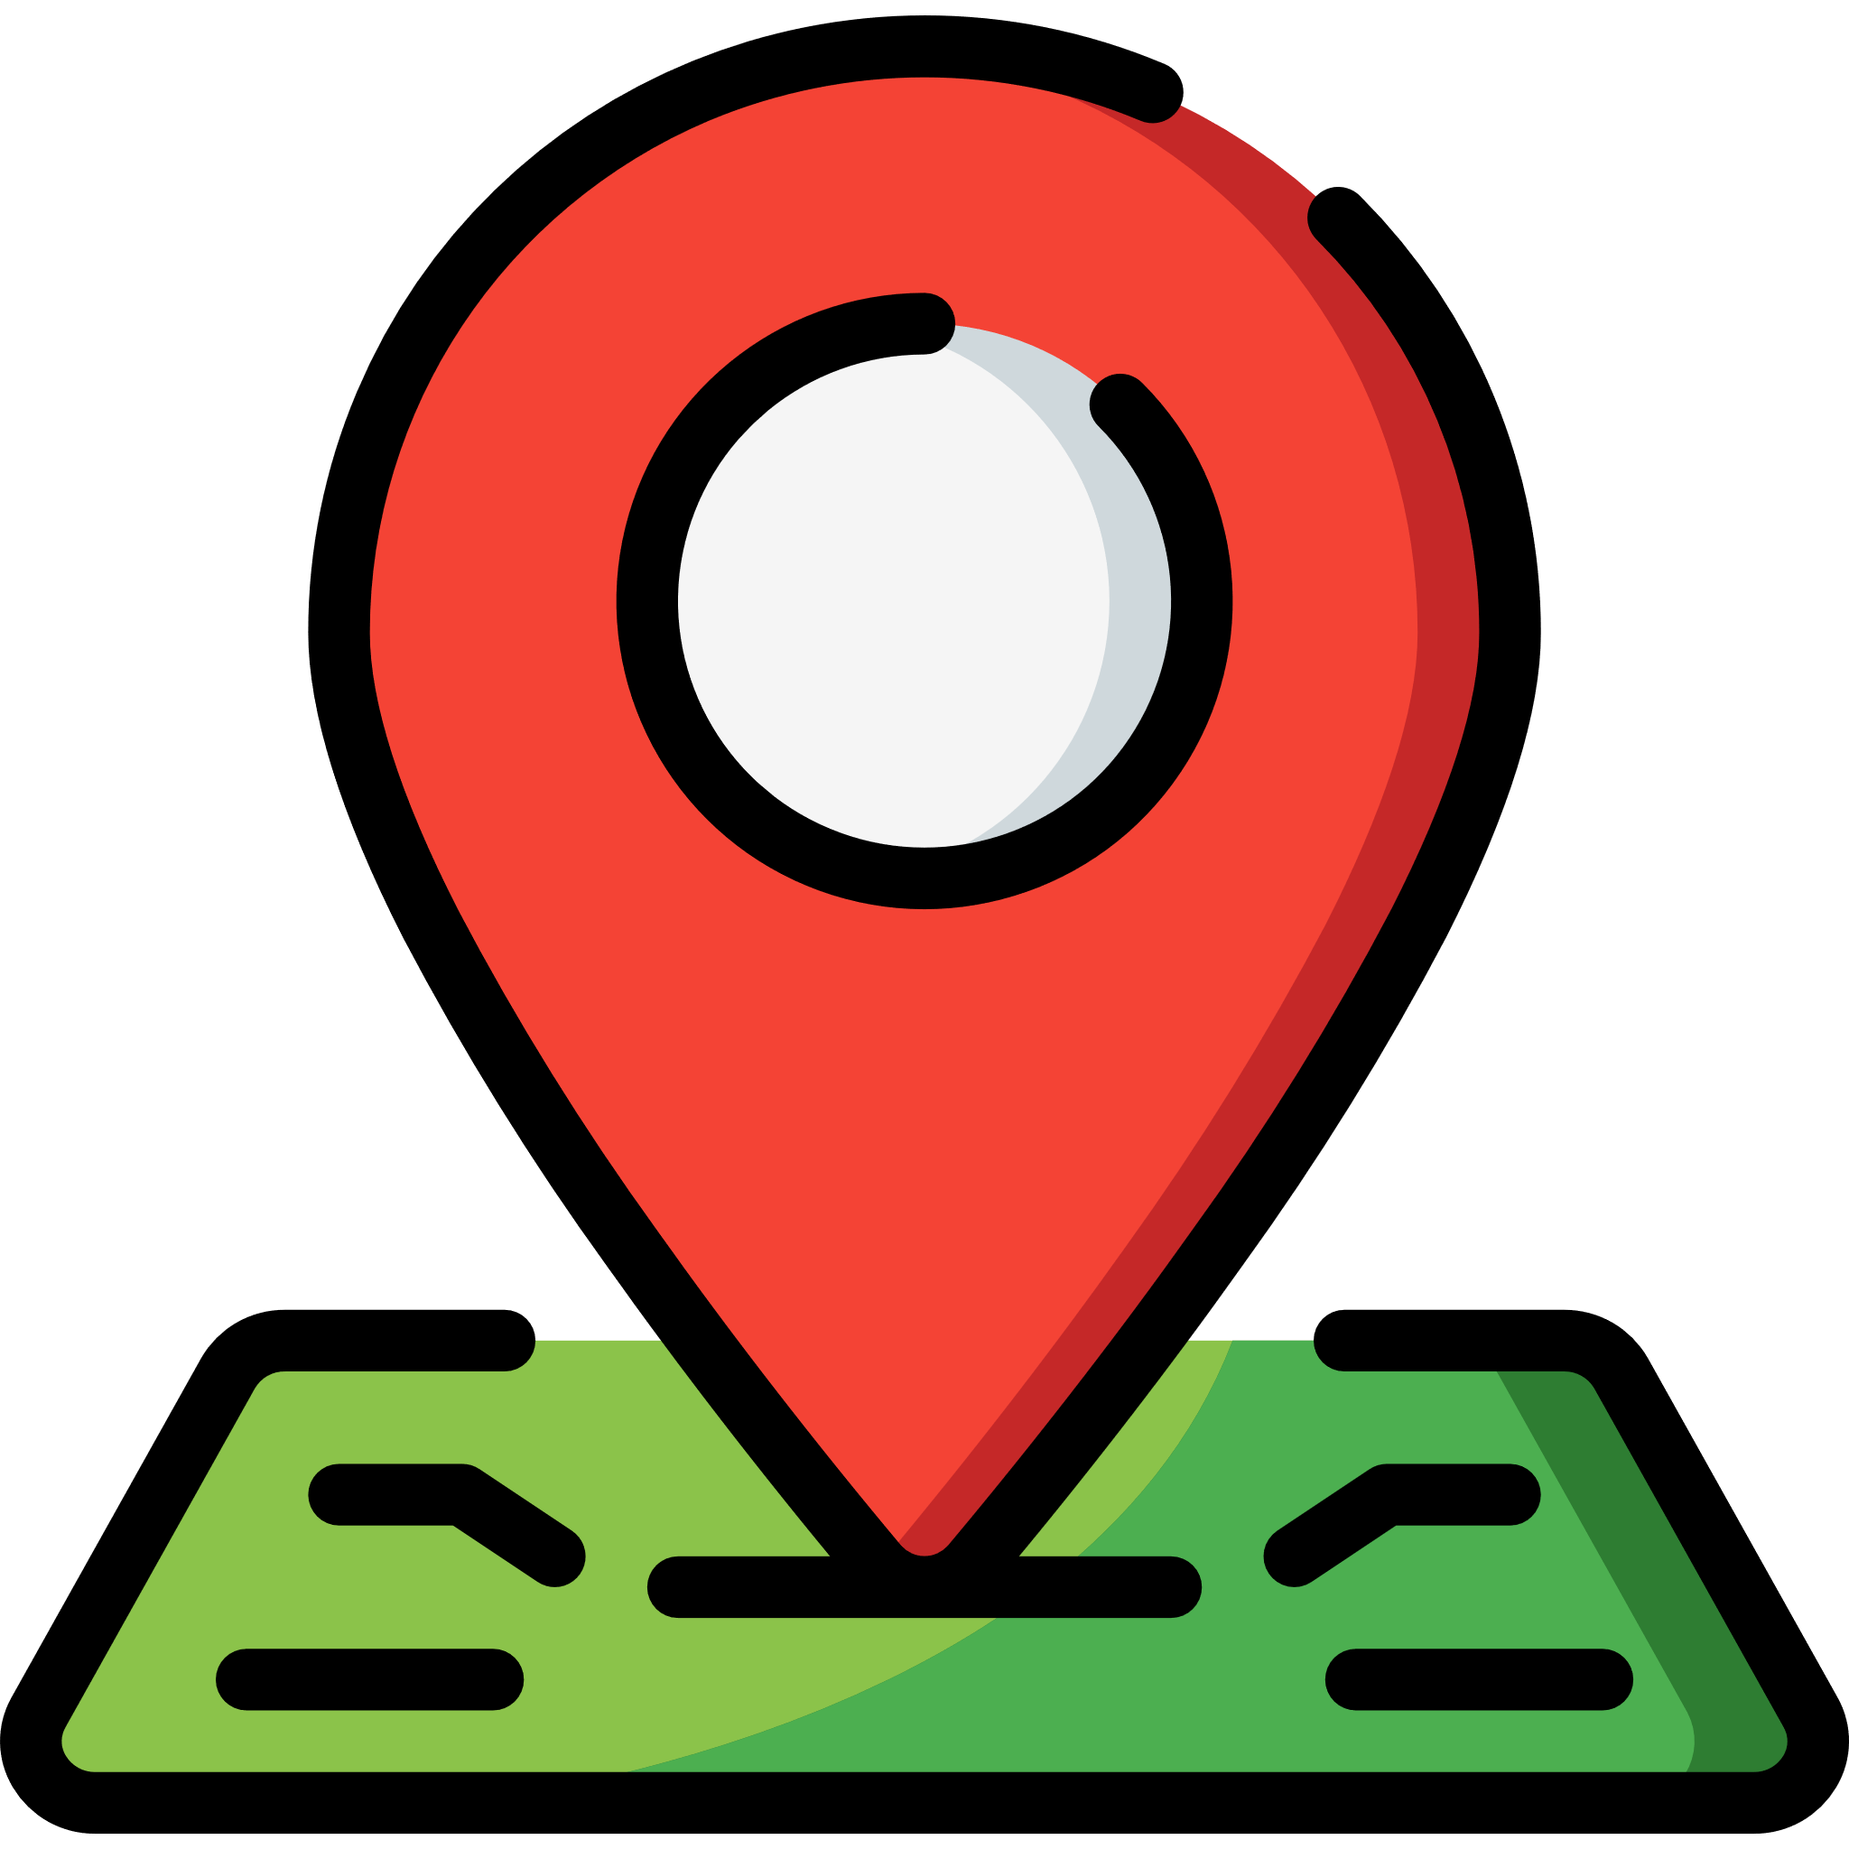



Required Features
Search clinics by name
View all clinics in map view
View all clinics in list view
View clinic information in detail
Upload reviews for clinic

Slide 10

Requirement Analysis

Slide 11



Identify Actors
User
Google
Data.gov.api

Slide 12
Identify Cases
Search Clinic
Login
And many more
Review Clinic
View List of Clinic

Slide 13
Use Case Model
Search Clinic
wants to
User

Slide 14
Use Case Model
Search Clinic
wants to
provide data
Data.gov.api
User

Slide 15
Conceptual Model
MapUI
ClinicUI
MapController
ClinicController
Clinic

Slide 16
Conceptual Model
<<entity>>
Clinic
-clinicCode : String
-clinicName : String
-licenseType : String
-clinicTelNo : String
-postalCode : int
-addrType : int
-blkHseNo : String
-floorNo : String
-unitNo: String
-streetName : String
-buildingName : String
-programmeCode : String
-XCoordinate : double
-Ycoordinate : double
-incCrc : String
-fmelUpdD : String
+CREATOR : ParcelCreator<Clinic>
+constructors()...
+getters()...
+setters()...
Clinic

Slide 17
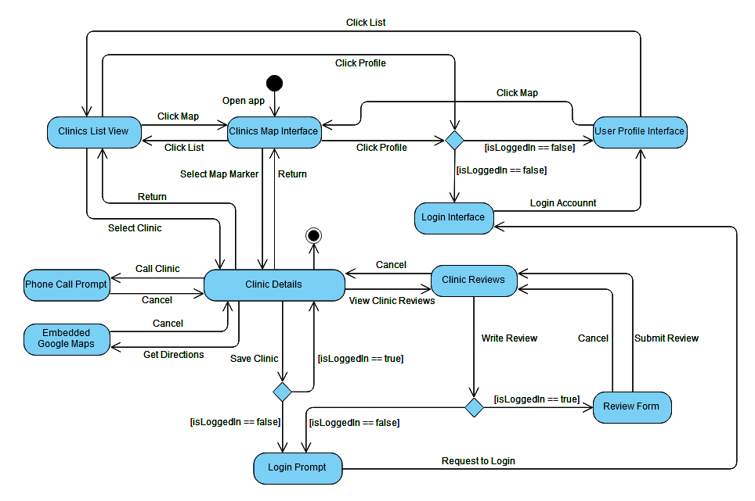
Dynamic Model

Slide 18
Design
&
Implementation

Slide 19
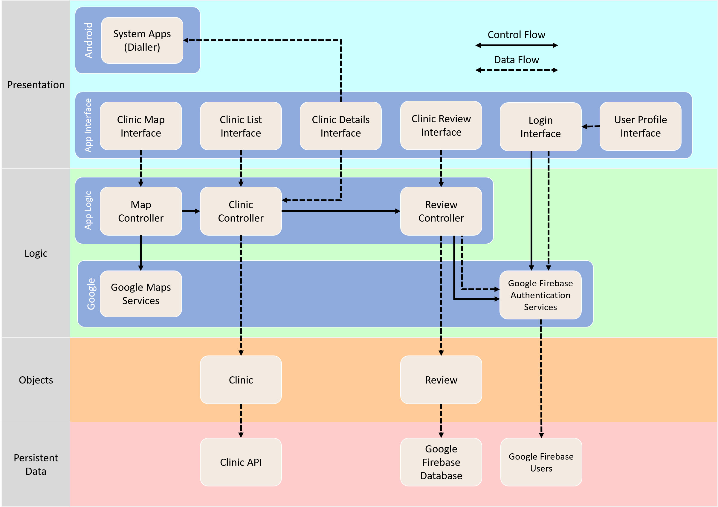
System Architecture

Slide 20



Advantages
Easy Upgradability
Loose Couple
Modular

Slide 21





APIs Used

Slide 22
Testing

Slide 23
Blackbox Test

Slide 24
Whitebox Test

Slide 25


Recommendations
Non CHAS clinic support
Crowd density detection
Appointment booking

